Slide 1


Advanced Skin Solutions

Slide 2
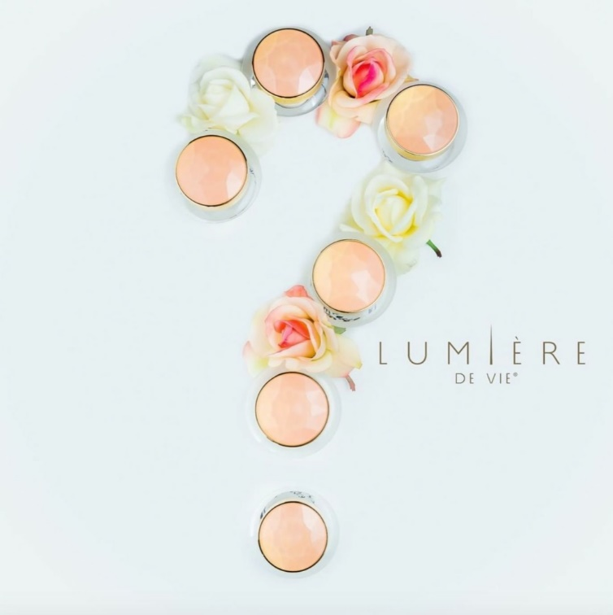
Let’s RECAP Skin Type
As learned in Skincare 1 to 1 course

Slide 3
Customised Solutions
When trying to decide which products are best suited for each customer you will want to:
  Determine what skin type your client has
    Then you can recommend the appropriate cleanser, toner and moisturiser.
  Understand the different skin conditions your customer may be suffering from (utilising the S.O.A.P method discussed in Skincare 1 to 1 class)
    Offer solutions through the use of targeted treatment products

Slide 4
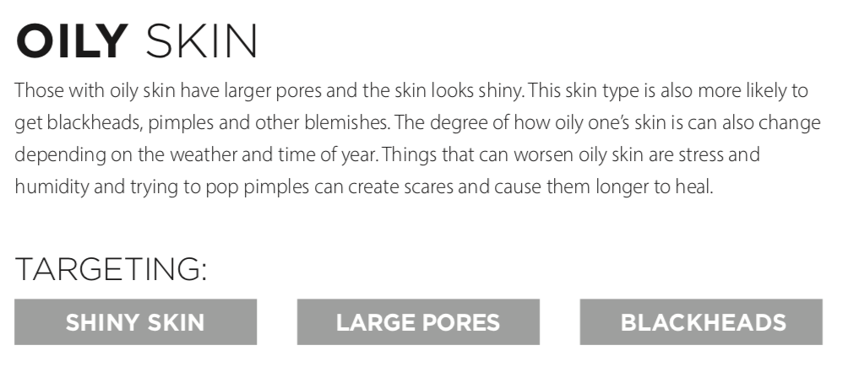
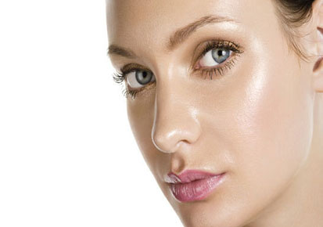
Skin Type
This Photo by Unknown Author is licensed under CC BY-NC

Slide 5
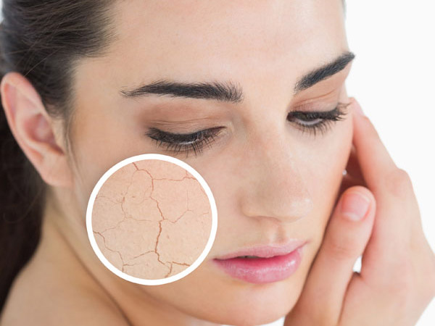
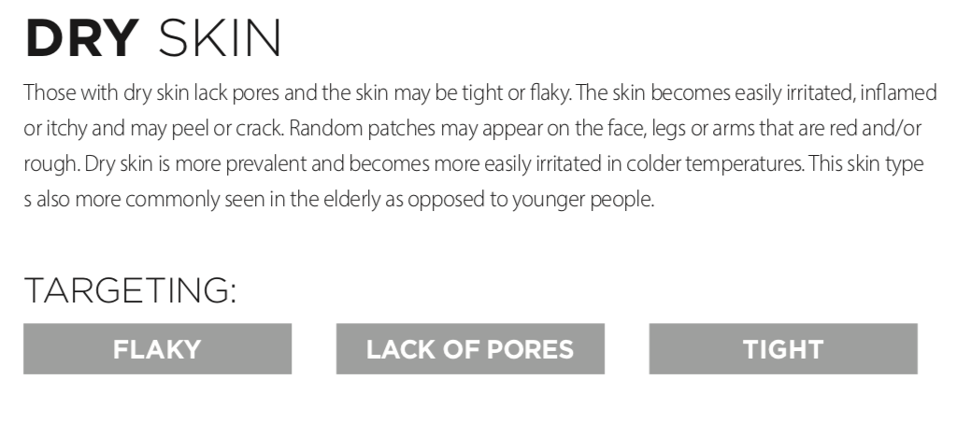
Skin Type
This Photo by Unknown Author is licensed under CC BY-NC

Slide 6
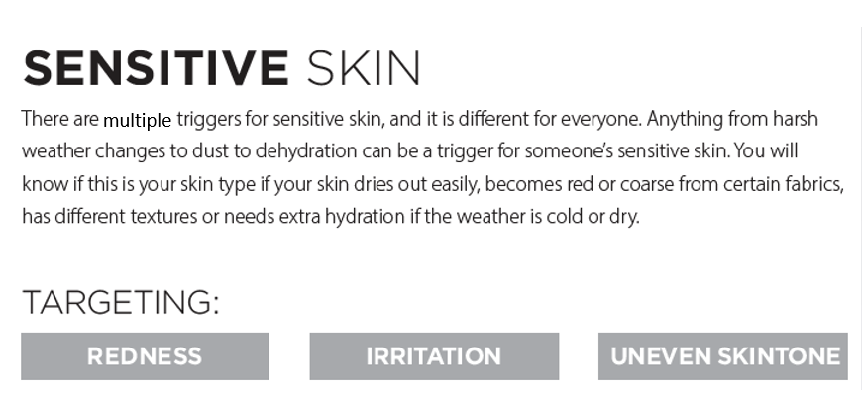
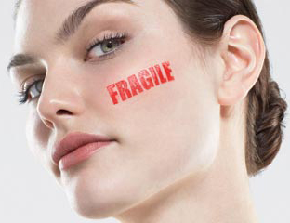
Skin Type
This Photo by Unknown Author is licensed under CC BY-NC

Slide 7
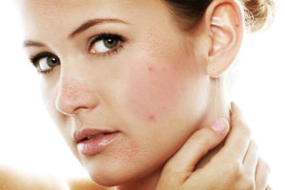
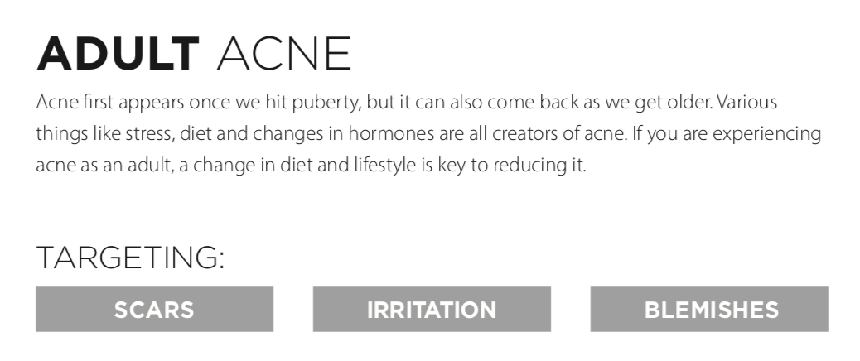
Skin Type
This Photo by Unknown Author is licensed under CC BY-NC-ND

Slide 8
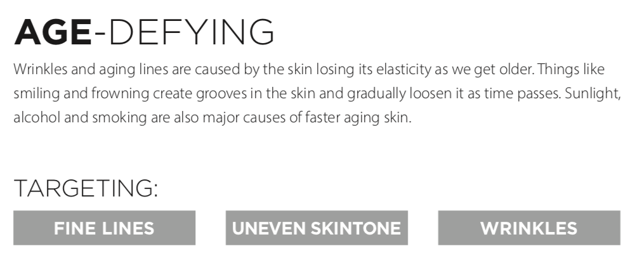
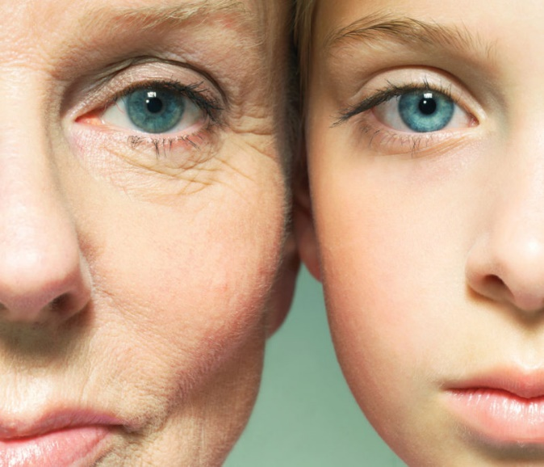
Skin Type
This Photo by Unknown Author is licensed under CC BY-NC

Slide 9
SKIN TYPE
NORMAL
Not too dry and not too oily, normal skin has:
  No or few imperfections
  No severe sensitivity
  Barely visible pores
  A radiant complexion
COMBINATION
Your skin can be dry or normal in some areas and oily in others, such as the T-zone (nose, forehead, and chin). Many people have this type.

Slide 10
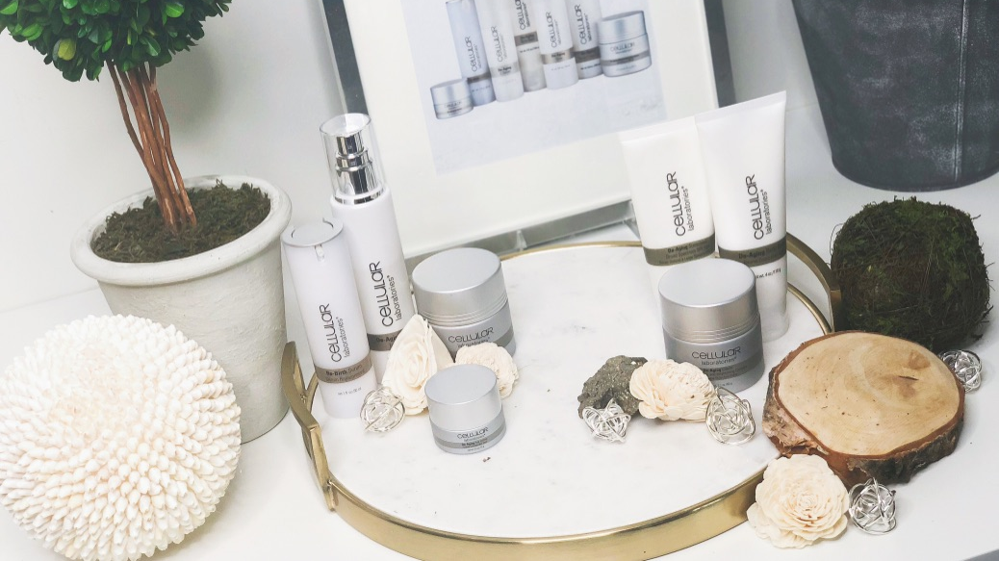
Customised Solutions

Slide 11
Customised Solutions
Skin Care Systems
Product Line | Skin Type | Benefits
Cellular Laboratories® | Dry, Mature | Scientifically engineered with award winning ingredients to minimise appearance of lines and wrinkles, protect the skin and support the skin on a cellular level.
Lumière de Vie® | All Skin Types, esp. suited for anti-aging | Uses the highest quality natural ingredients and powerful formulas that help to heal, soothe, moisturise and protect the skin.
Skintelligence® | All Skin Types, esp. sensitive skins | Simple and effective products, designed for both men and women of all ages. Helps to balance and maintain the health of skin.

Slide 12
Customised Solutions
Customise a program for your customer that is within their reach and consider each individual’s unique circumst­ances.
Unlike department stores, you can deliver personalised service and recommend a targeted program based on
  skin type, lifestyle, customer background and ethnicity.
Take everything into consideration and advise customers that they can expect to see the look of their skin improve.

Slide 13

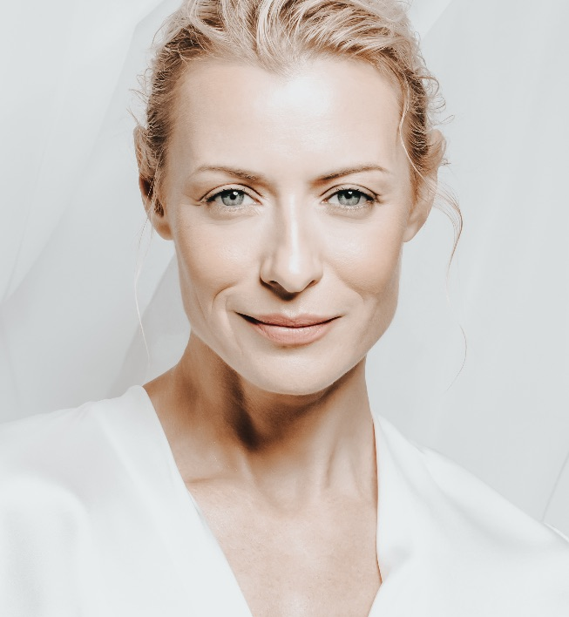
Correct Application
Step One
  Cleanse
Step Two
  Tone and Normalise
Step Three
  Exfoliation (1-3 times a week)
  Treat and Special Care
Step Four
  Moisturise and Protect

Slide 14
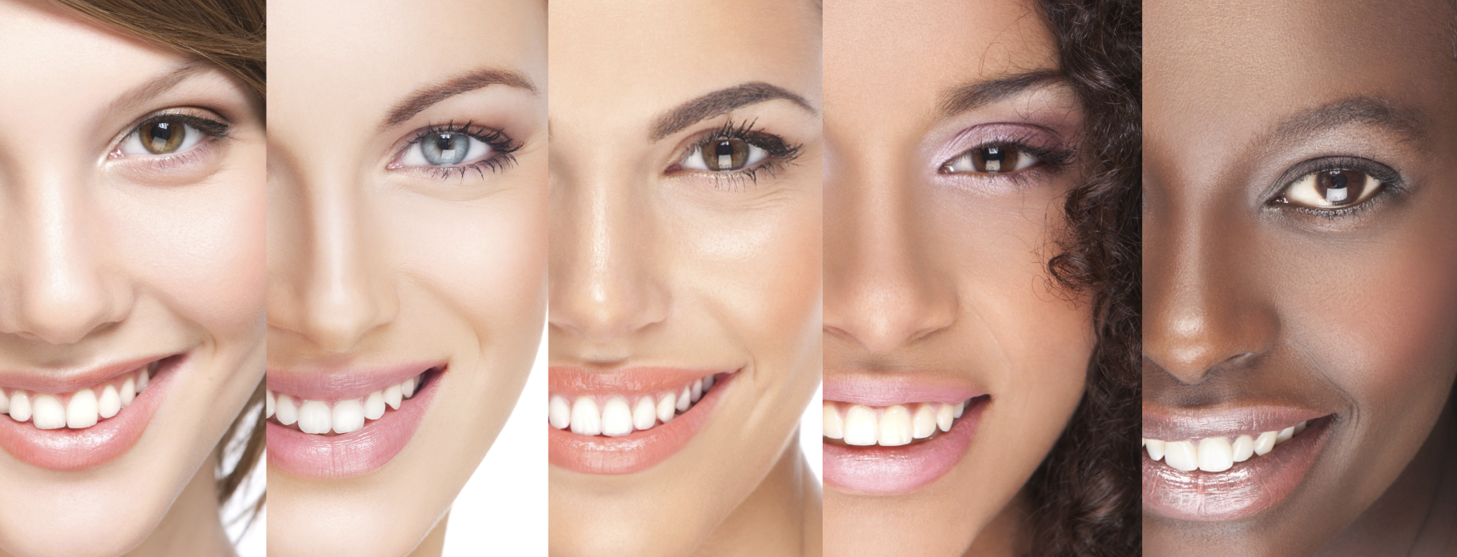
Skin Pigmentation
This Photo by Unknown Author is licensed under CC BY-NC

Slide 15
Skin Pigmentation
Pigmentation means colouring
Skin pigmentation disorders affect the colour of your skin.
Your skin gets its colour from a pigment called melanin.
Special cells in the skin make melanin.
When these cells become damaged or unhealthy, it affects melanin production.
If your body makes too much melanin, your skin gets darker.
Pregnancy and sun exposure all can make your skin darker.
If your body makes too little melanin, your skin gets lighter.
Vitiligo is a condition that causes patches of light skin.
Albinism is a genetic condition affecting a person's skin.
Infections, blisters and burns can also cause lighter skin.

Slide 16
HYPERPIGMENTATION | ROSEACEA
ACNE | AGING SKIN
Skin Conditions & Suggested Solutions
This Photo by Unknown Author is licensed under CC BY-NC

Slide 17
HYPERPIGMENTATION

Slide 18
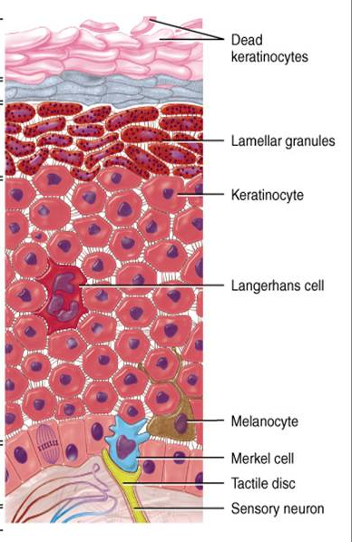
What is Hyperpigmentation?
Hyperpig­mentation is an increase of melanin, melanin, is a pigment found in the skin, eyes, and hair it is the natural substance that gives skin its colour and pigment, an increase of this causes darkening of the skin.
At the base of the Epidermis is the Melanocyte cell that is your skins’ melanin producing cell.
This cell releases melanin when the skin is under trauma example: sun burn, or picking blemishes causes your skin trauma, which releases melanin to protect itself hence leaving you with brown spots and uneven skin tone.

Slide 19
Hyperpigmentation Forms
Hyperpig­mentation appears in several different forms:
  Melasma is a patchy brown discolouration that occurs on sun exposed areas of the face typically during pregnancy or as a result of hormonal pills like birth control.
  Post-inflammatory hyperpig­mentation causes dark spots when skin is inflamed due to acne, eczema, psoriasis or other inflammatory conditions, particularly in darker skin types.
  Lentigines. These are also known as liver spots or age spots. They are found on 90% of people over the age of 60, and are caused by exposure to UV rays.
  Finally, sun damage one of the most common forms of hyperpig­mentation, consisting of dark spots and freckling of the skin due to sun overexposure.

Slide 20
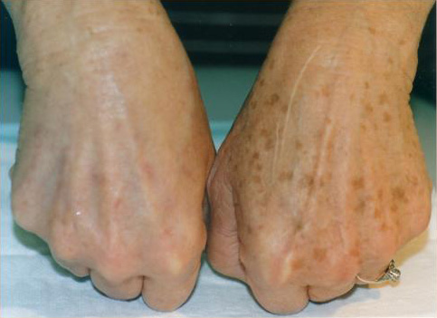
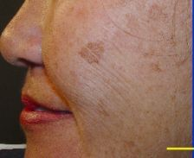
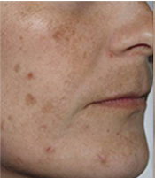
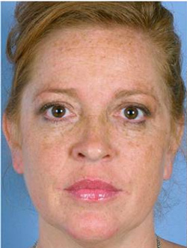
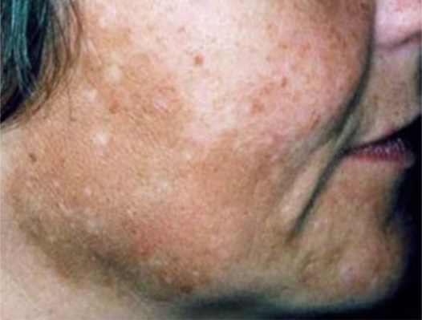
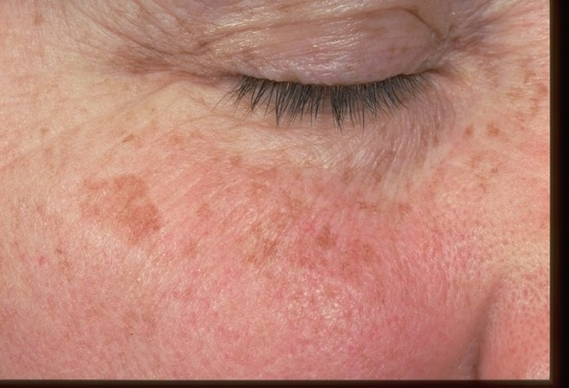
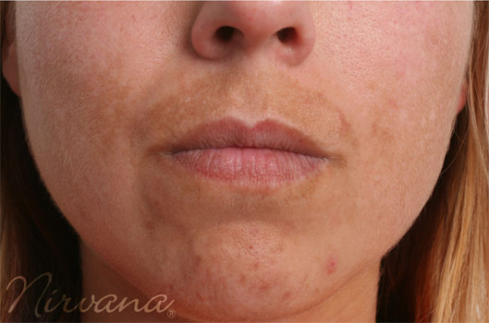
Hyperpigmentation

Slide 21
Hyperpigmentation Causes
Internal vs. External
  Hyperpig­mentation can be caused by both internal and external factors.
  Internal factors such as hormones, stress, nutrition, medical treatments and any other factor that changes the body’s natural regulatory functions can all result in excessive pigmentation on the skin.
  External factors are caused by the environment and include exposure to harsh weather conditions, sun exposure and physical touching/​rubbing of the skin, which can all cause hyperpig­mentation. Therefore, things like allergies, climate, clothing, chemicals and heat can all have a negative impact on the skin pigmentation.

Slide 22
Hyperpigmentation Solutions
Exfoliation + Lightening + Protect
  To reduce hyperpig­mentation, choose effective exfoliating ingredients that can aid in breaking up the brown spots, dead skin cells and help to increase cell turnover.
  Products that lighten the skin are very effective in minimising the appearance of brown spots and uneven skin tone.
  It would be more effective if you can combined products that exfoliate and lighten the skin into your regular skin care regimen.
  To provide your insurance policy you MUST use a sun block everyday.

Slide 23
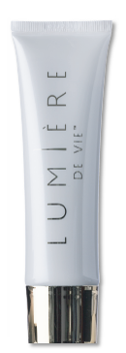
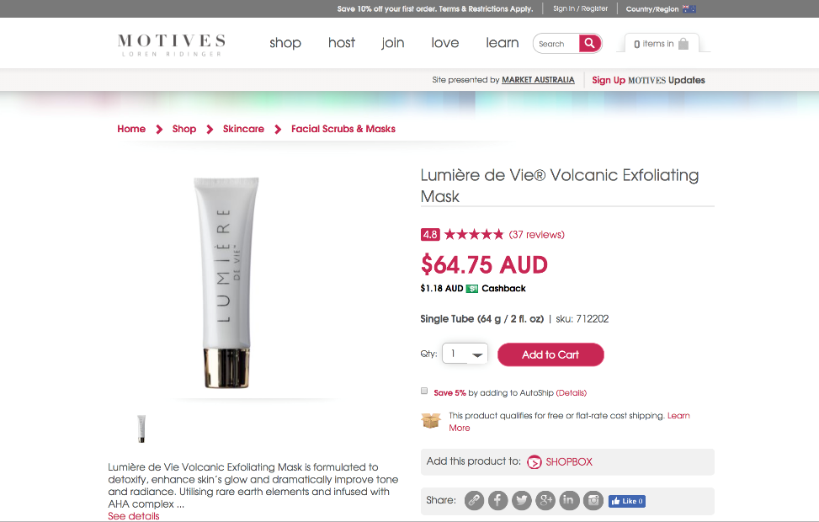
Lumière de Vie®
Volcanic Exfoliating Mask

Slide 24
Benefits & Ingredients
Benefits
  Exfoliates the skin for a refined, smoother, more radiant exposure
  Promotes healthy cell renewal for fresher, more vibrant-looking skin
  Reduces the appearance of fine lines and wrinkles
  Reduces the appearance of imperfections, irregularities and signs of aging
Ingredients
  PerfectionPeptide P3™: A unique, technologically-advanced tripeptide that promotes natural exfoliation of dead skin cells to support healthy cell renewal. Helps give the skin a smoother, more radiant appearance, and helps reduce the appearance of skin imperfections and irregularities.
  Sodium PCA: Powerful, natural moisturising agent that is found in human skin and is part of the natural moisturising factor of healthy skin. Has been shown to hydrate the skin more effectively than traditionally used compounds in skincare products.

Slide 25

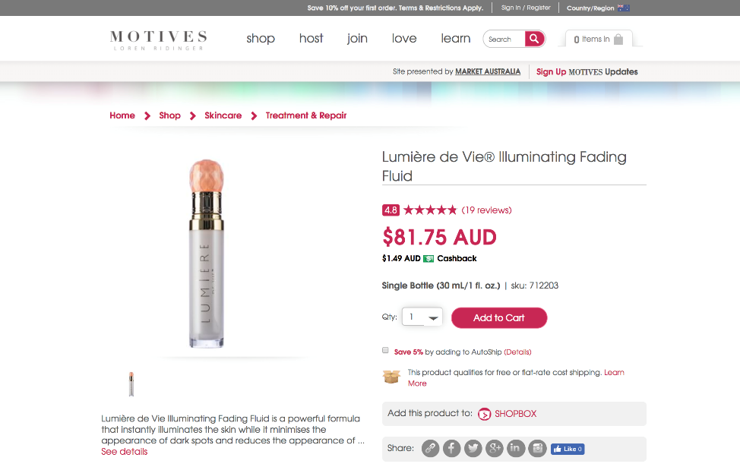
Lumière de Vie®
Illuminating Fading Fluid

Slide 26
Benefits & Ingredients
Benefits
  Reduces the appearance of dark spots
  Promotes a more even-looking skin tone by reducing the appearance of dark spot contours
  Brightens the skin’s overall appearance for a more radiant complexion
Ingredients
  Illumiscin®: A combination of olive leaf extract, stabilised vitamin C and zinc PCA that reduces the appearance of dark spots and age spots, and promotes an even skin tone by reducing the appearance of dark spot contours to give your skin a healthy, radiant glow.
  Bisabolol: This liquid is the main active component of the oil made from the German chamomile plant. Bisabolol is used as a skin conditioning agent to make the skin look and feel soft, smooth, and supple.

Slide 27
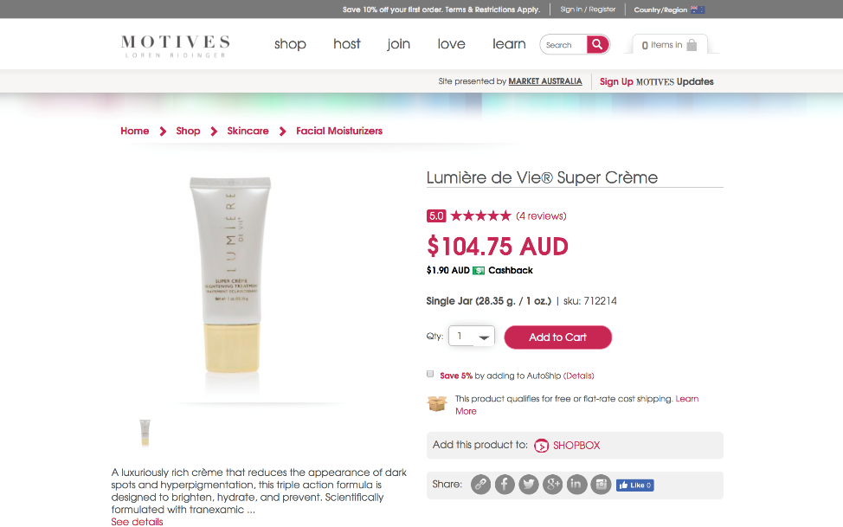
Lumière de Vie®
Super Crème

Slide 28
Benefits & Ingredients
Benefits
  Designed to brighten, hydrate and prevent
  Visibly reduces the appearance of age/dark spots, redness and hyperpigmentation
  Innovative formula utilises Tranexamic Acid to brighten and restore the skin’s natural radiance
  Helps reduce sebum (oil) build up while leaving the skin feeling flawless and healthy
  Moisturises to give skin a smoother and softer appearance
Ingredients
  Tranexamic Acid
  Tranexamic Acid is a synthetic derivative of the amino acid lysine and is classified as a skin conditioning agent. Tranexamic acid also has skin brightening properties that help reduce the appearance of dark spots for a more even-looking complexion.
  Advanced Moisture Complex (Glycerin & Water & Sodium PCA & Urea & Trehalose & Triacetin & Polyquaternium-51 & Sodium Hyaluronate): This blend of ingredients provides rapid and long-term skin hydration, helping to keep the skin looking smooth and soft.

Slide 29
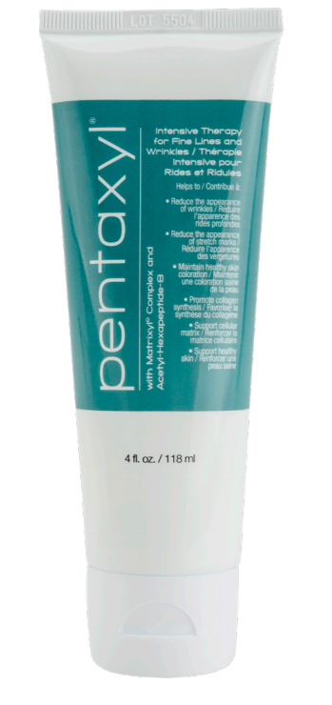
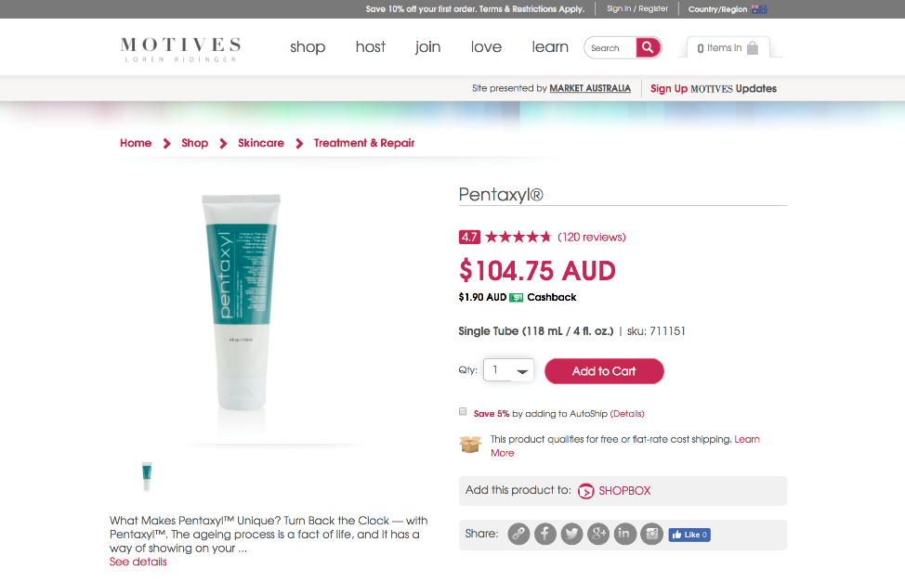
Pentaxyl®

Slide 30
Benefits & Ingredients
Benefits
  Reduces the appearance of stretch marks and wrinkles
  Maintains healthy skin colouration and increases hydration
  Supports smooth skin texture and color
**Remember, always apply Pentaxyl first, then apply a moisturiser on top. Apply in circular motions.
Ingredients
  Matrixyl®: Matrixyl is the trademark name for palmitoyl pentapeptide-3. This breakthrough ingredient supports healthy collagen in the skin. Matrixyl becomes even more effective when combined with other peptides.
  Acetyl Hexapeptide-3: Acetyl Hexapeptide-3 is a unique blend of three amino acids that has been reported to reduce the appearance of wrinkles on the forehead and eyes caused by facial expression muscles.

Slide 31
Hyperpigmentation Causes
To PREVENT further Hyperpigmentation:
  Limit your exposure to UV rays. Exposure to UV rays is one of the most common causes of hyperpigmentation. While limiting exposure will do nothing to affect hyperpigmentation you already have it can help prevent further discolouration.
  Don't use tanning beds.
  Limit your time outside and don't sunbathe.
  Always wear sunscreen. In strong, direct sun, wear a hat and long sleeves.

Slide 32
AGEING SKIN

Slide 33
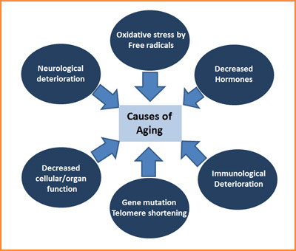
What causes Ageing?
Many things cause our skin to age. Some things we cannot do anything about; others we can influence.
  One thing that we cannot change is the natural ageing process. With time, we all get visible lines on our face. It is natural for our face to lose some of its youthful fullness. We notice our skin becoming thinner and drier. Our genes largely control when these changes occur. The medical term for this type of aging is “intrinsic ageing.”
  We can influence another type of aging that affects our skin. Our environment and lifestyle choices can cause our skin to age prematurely. The medical term for this type of ageing is “extrinsic ageing.” By taking some preventive actions, we can slow the effects that this type of aging has on our skin.

Slide 34
Skin Changes with AGE
As we grow older, changes like these naturally occur:
  Skin becomes rougher.
  Skin becomes slack. The loss of the elastic tissue (elastin) in the skin with age causes the skin to hang loosely.
  Skin becomes more transparent. This is caused by thinning of the epidermis (surface layer of the skin).
  Skin becomes more fragile. This is caused by a flattening of the area where the epidermis and dermis (layer of skin under the epidermis) come together.
  Skin becomes more easily bruised. This is due to thinner blood vessel walls .

Slide 35
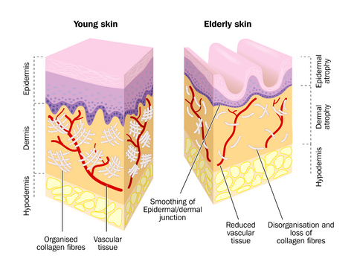
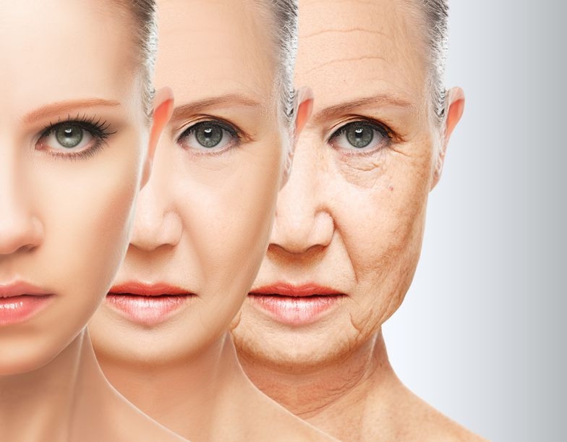
Ageing Skin

Slide 36
Treatment for Ageing Skin
Cleanse your skin gently. Scrubbing your skin clean can irritate your skin. Irritating your skin accelerates skin ageing. Gentle washing helps to remove pollution, makeup, and other substances without irritating your skin.
Use specialised products. Choose products that help increase collagen production and support skins elasticity.
Apply a facial moisturiser every day. Moisturiser traps water in our skin, giving it a more youthful appearance.
Stop using skin care products that sting or burn. When your skin burns or stings, it means your skin is irritated. Irritating your skin can make it look older.

Slide 37
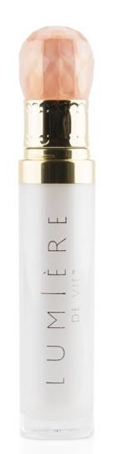
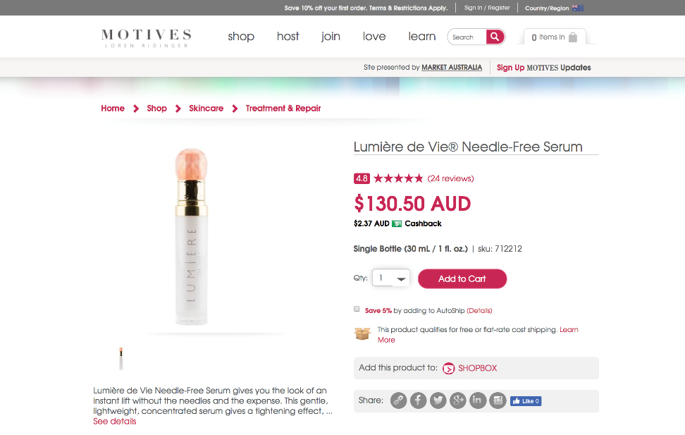
Lumière de Vie®
Needle-Free Serum

Slide 38
Benefits & Ingredients
Benefits
  Helps skin look firm
  Reduces the appearance of wrinkles
  Provides a quick tightening effect for taut-looking skin
  Helps calm and soothe sensitive skin
  Hydrates skin so it looks smoother and more supple
Ingredients
  Neodermyl®: is a combination of a glucose-based compound, amino acids and copper. This unique combination helps the skin to look firmer and more supple, while helping to reduce the appearance of fine lines and wrinkles.
  Liftonin®-Xpress: this polymer matrix blend has been optimised to give a rapid and noticeable physical tightening effect. This tightening effect minimises the appearance of fine lines and wrinkles for a smoother-looking complexion.

Slide 39
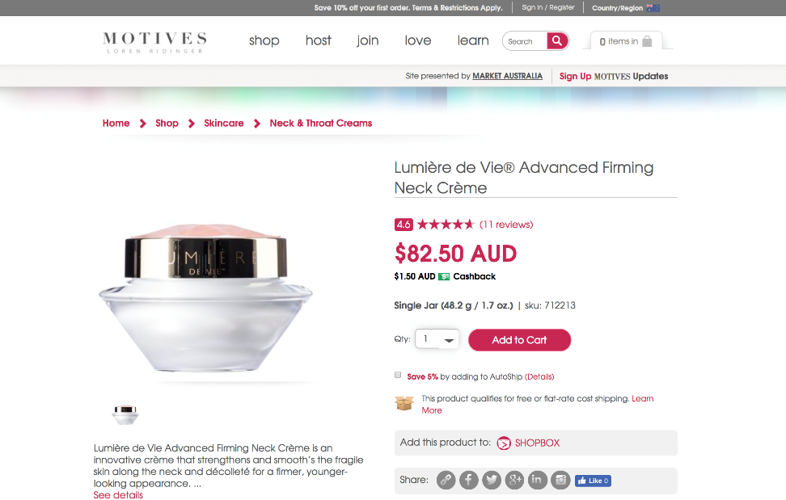
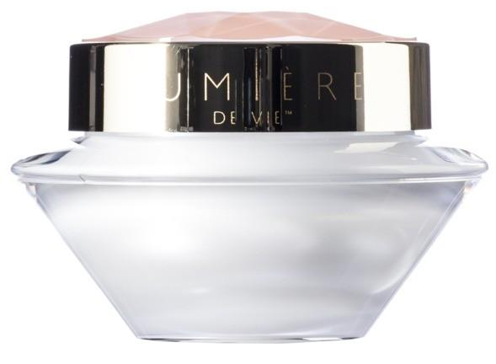
Lumière de Vie®
Advanced Firming Neck Creme

Slide 40
Benefits & Ingredients
Benefits
  Helps the skin look firmer and more supple
  Reduces the appearance of wrinkles
  Provides a rapid tightening effect for skin that feels more taut
  Moisturises for more hydrated, smoother-feeling
Ingredients
  Essenskin™: is defined as a “complementary source of calcium and essential amino acids through the synergetic association of calcium hydroxymethionine and homotaurine.” This unique ingredient helps the skin look firmer and suppler, and reduces skin roughness for more refined, smoother-looking skin.
  Liftonin®-Xpress: this polymer matrix blend has been optimised to give a rapid and noticeable physical tightening effect. This tightening effect minimises the appearance of fine lines and wrinkles for a smoother-looking complexion.

Slide 41
Pentaxyl®

Slide 42
Benefits & Ingredients
Benefits
  Reduces the appearance of stretch marks and wrinkles
  Maintains healthy skin colouration and increases hydration
  Supports smooth skin texture and colour
**Remember, always apply Pentaxyl first, then apply a moisturiser on top. Apply in circular motions.
Ingredients
  Matrixyl®: Matrixyl is the trademark name for palmitoyl pentapeptide-3. This breakthrough ingredient supports healthy collagen in the skin. Matrixyl becomes even more effective when combined with other peptides.
  Acetyl Hexapeptide-3: Acetyl Hexapeptide-3 is a unique blend of three amino acids that has been reported to reduce the appearance of wrinkles on the forehead and eyes caused by facial expression muscles.

Slide 43
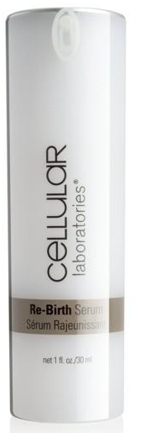
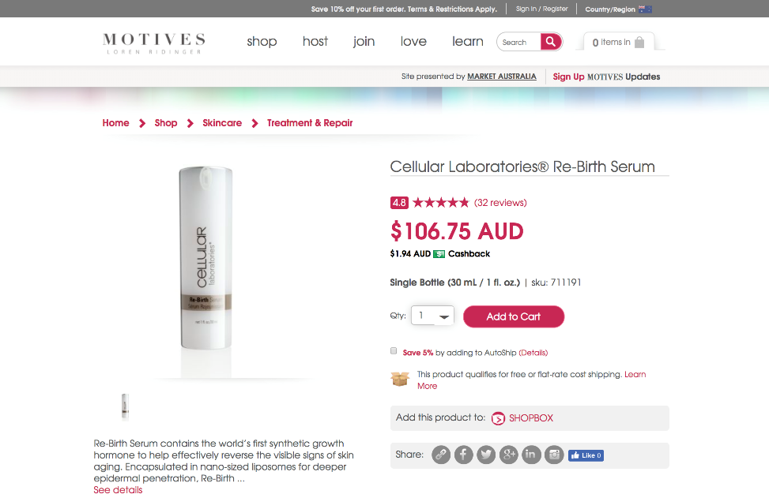
Cellular Laboratories®
Rebirth Serum

Slide 44
Benefits & Ingredients
Benefits
  Helps protect the skin against the effects of pollution as it promotes skin’s defenses against the most prevalent cause of wrinkles and natural degradation
  Reduces the appearance of lines and wrinkles
  Promotes glowing skin and luminosity
Ingredients
  Sh-polypeptide-7 A synthetic peptide stabilised in nano-sized liposomes that can help fight the visible signs of aging and promote the appearance of younger-looking skin. Helps reduce the appearance of lines and wrinkles and promotes healthy cellular vitality.
  Anhydroxylitol, Xylitylglucoside & Xylitol A proprietary, dual function ingredient that increases skin moisturisation. Anhydroxylitol is a carbohydrate-derived compound that acts as a humectant to help maintain skin hydration. The moisturising properties of anhydroxylitol and its relatives, xylitylglucoside and xylitol, help condition the skin so that it looks and feels smoother and softer.

Slide 45
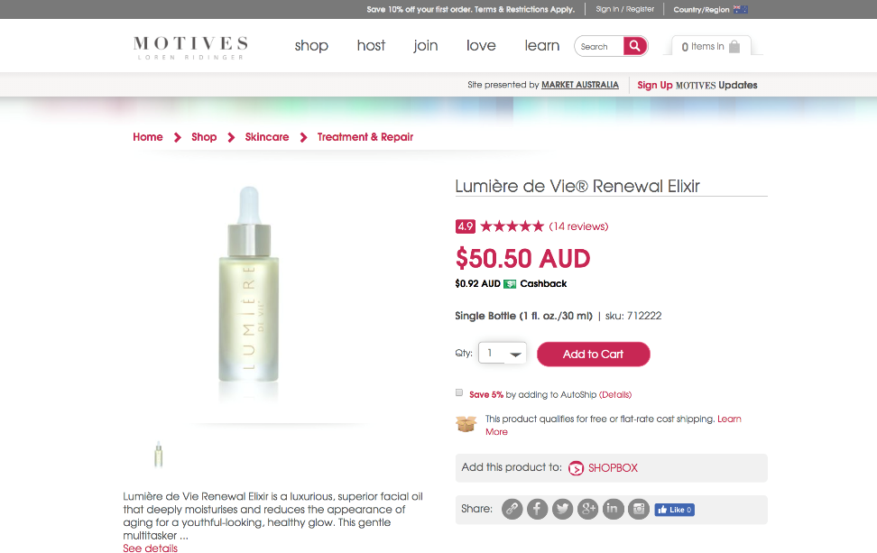
Lumière de Vie®
Renewal Elixir

Slide 46
Benefits & Ingredients
Ingredients
  Revinage® -a proprietary blend of Bidens Pilosa Extract, Palm Oil, Cottonseed Oil, and Flaxseed Oil. This multi-functional ingredient helps reduce the appearance of wrinkles for a smoother-looking complexion, helps reduce the appearance of dark spots for a more even-toned appearance, and helps the skin feel more supple.
  Caprylic/Capric Triglyceride-a liquid ingredient made from fatty acids found in coconut oil and glycerin. It is classified as both an emollient and an occlusive skin conditioning agent. As such caprylic/capric triglyceride helps lubricate the skin, keeping it feeling soft and smooth and helps moisturise the skin by forming a barrier on the skin's surface to slow the loss of water.
Benefits
  Moisturises to reduce the appearance of rough skin
  Supports skin elasticity
  Reduces the appearance of wrinkles and dark spots
  Helps skin feel firmer for younger-looking skin
  Add to your favourite moisturiser for ultimate hydration

Slide 47
ACNE

Slide 48
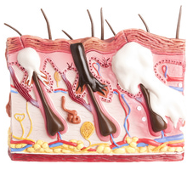
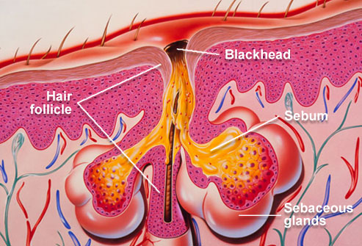
What is Acne?
Acne is one of the most troublesome and common skin-care problems.
  Although most often associated with teenagers and the onset of puberty, the truth is that you can get acne at any age, which makes it even more frustrating.
Human skin has pores (tiny holes) which connect to oil glands located under the skin. The glands are connected to the pores via follicles - small canals.
  These glands produce Sebum, an oily liquid. The sebum carries dead skin cells through the follicles to the surface of the skin.
Acne is caused when these follicles get blocked by a mixture of oil and dead cells which then allows for bacteria to grow.

Slide 49
Acne Causes
There are three major factors that cause acne to develop. The result of these factors coming together is a formation of acne breakouts. All three factors must be present in order for acne to occur.
Overactive Sebaceous Glands
  Sebaceous glands create sebum, or oil, needed to lubricate the skin's surface. Those who are prone to acne have oil glands that produce more sebum than is necessary. Excess oil remains in the pore, blocking the sebaceous duct and creating a blockage within the follicle.

Slide 50
Acne Causes
Abnormal Shedding of Skin Cells
  The epidermis is constantly shedding dead skin cells through a process called desquamation. Acne prone skin produces more dead skin cells than is typical, and the skin cells are not being shed properly. Instead, the cells remain stuck inside the follicle creating a comedo.
Proliferation of Bacteria
  In those with acne Bacteria grows out of control. The plug of dead cells and oil within the pore creates an anaerobic environment where oxygen can't get into the pore. Bacteria thrives in this environment.
  When you have oil, dead cells and bacteria trapped within the pore, it produces a fatty acid waste. This waste irritates the pore lining, causing redness and inflammation.

Slide 51
Acne Forms
Forms of Acne
  Acne can show up on many areas of the body, including the face, neck, chest, back, shoulders, and arms, it can actually take several forms, as described below:
    Comedones: This form of acne presents itself in two ways: whiteheads or blackheads. When these lesions are closed at the skin’s surface, they are flesh-coloured, slightly raised bumps called whiteheads. When they’re open, the exposure to air allows the plugs in the hair follicle to oxidise, resulting in a dark or black spot on skin called a blackhead. That dark spot is not dirt showing beneath the surface of skin!
    Papules: These are small, raised bumps that indicate inflammation is occurring in hair follicles.
    Pustules: Larger than papules, these red, tender bumps have white pus at their tips and are a sign of a more advanced, deeper inflammation.
    Nodules: One of the most painful forms of acne, these bumps remain below the surface of the skin and are large and solid. They develop when buildup occurs deep within hair follicles that are severely clogged.
    Cysts: Painful, pus-filled lumps that form beneath the skin, and that present an increased risk of scarring due to their depth and collagen-destroying potential.

Slide 52
Acne Grades
There are different grades (severity) of acne.
  Dermatologists classify types of acne into four grades. Determining acne grade is done by a simple visual inspection of the skin.
Knowing the grade of your customers acne is an important step.
  All acne grades require different treatment methods.
Understanding the grade of your customers acne can help you choose the products that may help.
  It will help you in selecting products.
  It will help you decide if you can treat their acne with at home care or if they should see a dermatologist.

Slide 53
Acne Grades
GRADE 1
  Description: This is the mildest form of acne. Grade 1 consists of blackheads mostly on the nose and a few papules which are small, red breakouts typically found on the cheeks. These breakouts are minimal and tend to be occasional.
GRADE 2
  Description: This is considered moderate acne and is characterised by blackheads, milia (whiteheads), inflammation, redness, papules and pustules. They are found usually on the nose, cheeks, and chin / jaw line. More than occasional, Grade 2 acne needs more active attention.

Slide 54
Acne Grades
GRADE 3
  Description: Very similar to Grade 2 but with more swelling, and the number of actual papules and pustules is increased significantly. Scarring tends to be more noticeable as well. In this case, it is found all over the face and neck in addition to other acne-prone areas such as the chest, back and upper arms.
  A dermatologist should treat acne at this stage.
GRADE 4
  Description: It is the most severe form of acne and is extremely rare. Usually the skin is covered by an extreme number of pustules and edema (swelling). They will have more unhealthy tissue then healthy tissue.
  This condition can only be treated by a dermatologist.

Slide 55
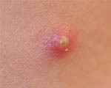
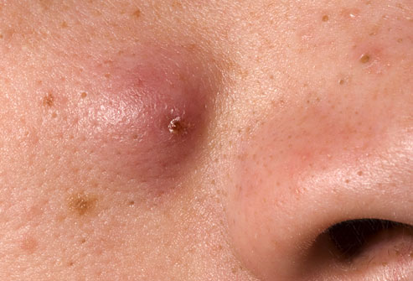
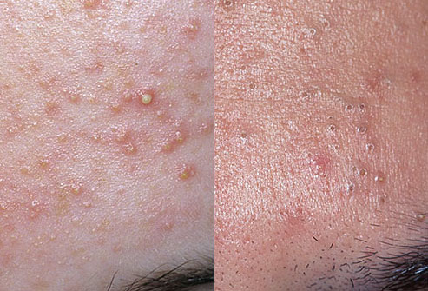
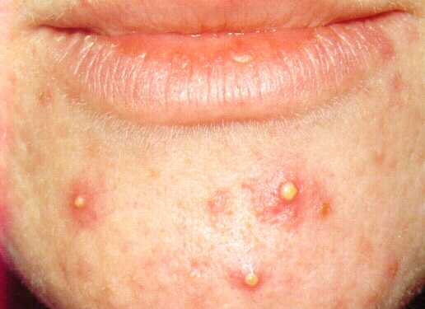
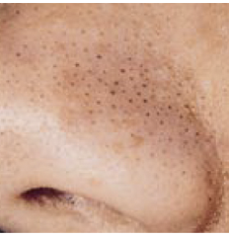
Acne

Slide 56
Acne Treatments
Anything you can do to reduce inflammation will help acne heal faster
  the reverse is true as well, over drying the skin or stripping the skin with aggressive products will make the acne worse!

Slide 57
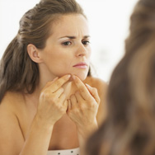

Acne Prevention
Menstrual cycle - acne tends to get worse one or two weeks before your menstrual period arrives due to hormonal changes that take place. Some people say they eat more chocolate during this time and wonder whether there may be a connection. However, the worsening of acne is not due to chocolate, but rather to hormonal changes.
Anxiety and stress - mental stress can affect your levels of some hormones, such as cortisol and adrenaline, which in turn can make acne worse.
Hot and humid climates - when it is hot and humid we sweat more. This can make the acne worse.
Oil based makeups - moisturising creams, lubricating lotions,
and all makeup that contain oil can speed up the
blocking of your pores
Greasy hair - some hair products are very greasy and might
have the same effect as oil based makeup.
Squeezing the pimples - if you try to squeeze pimples your
acne is more likely to get worse, plus you risk scarring.

Slide 58
ROSACEA

Slide 59
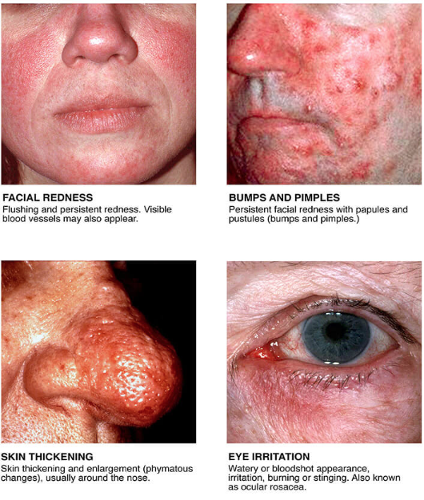
What is Rosacea?
is a chronic but treatable condition that primarily affects the central face, and is often characterised by flare-ups and remissions.
Studies have shown that over time the redness tends to become ruddier and more persistent, and visible blood vessels may appear.
Left untreated, inflammatory bumps and pimples often develop, and in severe cases — particularly in men — the nose may grow swollen and bumpy from excess tissue.
In as many as 50 percent of patients the eyes are also affected, feeling irritated and appearing watery or bloodshot.
https://www.rosacea.org/patients/all-about-rosacea

Slide 60
Rosacea Causes
Experts are not sure what causes rosacea. The following related factors are thought to contribute:
Abnormalities in facial blood vessels:
  Skin specialists (dermatologists) suggest that abnormalities in the blood vessels of the face cause the flushing, persistent redness, and visible blood vessels. What causes the inflammation of the blood vessels is still a mystery.
Light skin colour:
  A much higher percentage of people with fair skin develop rosacea compared with other people.
Demodex folliculorum (microscopic mite):
  lives on human skin and usually causes no problems. However, patients with rosacea have much higher numbers of these mites than others do. It is unclear whether the mites cause the rosacea, or whether the rosacea causes the overpopulation of the mites.
H. pylori bacteria:
  H. pylori, a bacteria found in the gut, stimulates the production of bradykinin, a small polypeptide known to cause blood vessels to dilate.
https://www.medicalnewstoday.com/articles/160281.php

Slide 61
Rosacea Treatments
There is no cure for rosacea. However, there are various treatments which can relieve the signs and symptoms.
Rosacea makes the skin extremely sensitive. Because the skin is so sensitive, many things can cause rosacea to flare.
  Time spent in the sun can lead to unexpected flushing that lasts for hours. Any number of skin care products may cause your face to sting, burn, or itch for what seems an eternity.
  Anything that causes your rosacea to flare is called a trigger. Sunlight and hairspray are common rosacea triggers. Other common triggers include heat, stress, alcohol, and spicy foods.
https://www.aad.org/public/diseases/acne-and-rosacea/rosacea/triggers-could-be-causing-your-rosacea-flare-ups

Slide 62
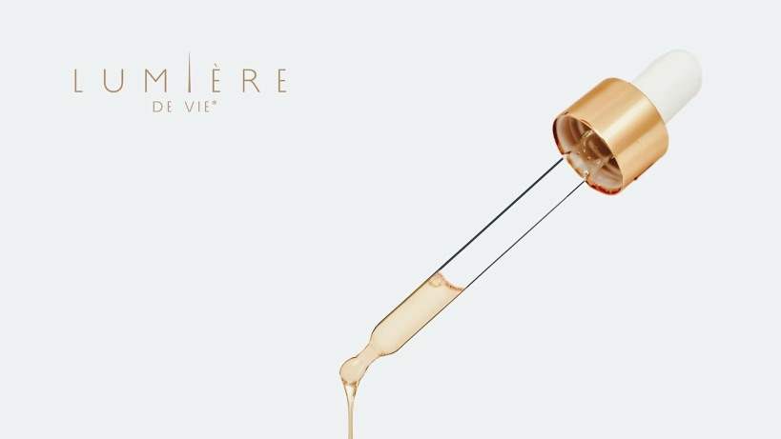
Rosacea Symptoms Treatments
Let’s talk about some products that may help the skin in a natural healing process.

Slide 63
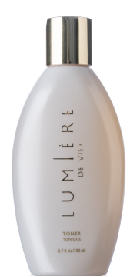
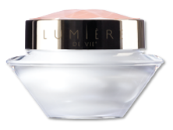
Lumière de Vie
Skincare Value Kit
Lumière de Vie Facial Cleanser helps to moisturise while cleansing, refreshing and invigorating the skin. The appearance of rough, dry skin is visibly diminished, creating skin that is softer and smoother.
Lumière de Vie Toner is an intensive toner that helps to support a radiant complexion by promoting healthy skin hydration, effectively reducing the appearance of rough, dry skin for a softer, smoother complexion.
Lumière de Vie Intense Rejuvenation Crème is a super-hydrating, intensive repair treatment developed for chronically-stressed skin and designed to work with the skin's renewal process.

Slide 64
Lumière de Vie®
Volcanic Exfoliating Mask

Slide 65
Benefits & Ingredients
Benefits
  Exfoliates the skin for a refined, smoother, more radiant exposure
  Promotes healthy cell renewal for fresher, more vibrant-looking skin
  Reduces the appearance of fine lines and wrinkles
  Reduces the appearance of imperfections, irregularities and signs of aging
Ingredients
  PerfectionPeptide P3™: A unique, technologically-advanced tripeptide that promotes natural exfoliation of dead skin cells to support healthy cell renewal. Helps give the skin a smoother, more radiant appearance, and helps reduce the appearance of skin imperfections and irregularities.
  Sodium PCA: Powerful, natural moisturising agent that is found in human skin and is part of the natural moisturising factor of healthy skin. Has been shown to hydrate the skin more effectively than traditionally used compounds in skincare products.

Slide 66

Skintelligence
Skin Perfecting Complex
Designed with proteins and amino acids that moisturise and lubricate the skin, Skintelligence Skin Perfecting Complex contributes to softer, healthier-looking skin.
This special formula is rich in natural extracts, such as dandelion, carrot, lemon grass and violet, which work together to refresh and enrich the skin with essential vitamins.
Skintelligence Skin Perfecting Complex also helps promote the normal repair of skin cells and enables them to retain moisture for longer periods, resulting in more youthful-looking skin.

Slide 67
Benefits & Ingredients
Benefits
  Provides super hydration to skin cells — mucopolysaccharides act as tiny blotters that attach to cells and bind moisture
  Significantly reduces the appearance of fine lines, wrinkles and other visible signs of aging
  Promotes the normal repair of skin cells
Ingredients
  Nayad Helps reduce the appearance of wrinkles, promotes normal skin thickness and colour, and reduces roughness and dryness.
  Sodium Hyaluronate A vital moisturiser and lubricant present in the interstitial spaces between the epidermal cells. Helps to promote the normal repair of skin cells. Promotes elasticity, flexibility and tone to the skin.
  Allantoin Nitrogen-containing organic compounds found in many plants, and has the ability to promote the growth of healthy tissue and support normal healing.
  Dandelion Extract Made from the leaf and the root. Used as a skin refresher and rich in vitamins A and C.
  Carrot Extract Has antioxidant properties and is rich in vitamin A and beta-carotene.

Slide 68
Lumière de Vie®
Illuminating Fading Fluid

Slide 69
Benefits & Ingredients
Benefits
  Reduces the appearance of dark spots
  Promotes a more even-looking skin tone by reducing the appearance of dark spot contours
  Brightens the skin’s overall appearance for a more radiant complexion
Ingredients
  Illumiscin®: A combination of olive leaf extract, stabilised vitamin C and zinc PCA that reduces the appearance of dark spots and age spots, and promotes an even skin tone by reducing the appearance of dark spot contours to give your skin a healthy, radiant glow.
  Bisabolol: This liquid is the main active component of the oil made from the German chamomile plant. Bisabolol is used as a skin conditioning agent to make the skin look and feel soft, smooth, and supple.

Slide 70


Daily Essentials
Four ESSENTIAL Customer Favourites!
Isotonix OPC-3®
The most powerful antioxidant supplement on the market today!
Isotonix® Multivitamin
Get TOTAL Nutrition!
Isotonix® Activated B-Complex
BOOST your B Vitamins
Isotonix® Calcium Plus
Essential for maintaining strong bones, healthy teeth and gums
*These statements have not been evaluated by the Food and Drug Administration. This product(s) is not intended to diagnose, treat, cure or prevent any disease.

Slide 71
Skin Structure & Product Delivery
Having the technology behind the delivery of ingredients is essential in order for a consumer to experience desired result!
Not all products in the marketplace will offer the same benefit (even with similar ingredients) due to the formula not being able to penetrate the Epidermis and work at the Dermis layer

Slide 72

Skin Structure
Epidermis
The epidermis is the relatively thin, tough, outer layer of the skin. Most of the cells in the epidermis are keratinocytes. They originate from cells in the deepest layer of the epidermis called the basal layer. New keratinocytes slowly migrate up toward the surface of the epidermis. Once the keratinocytes reach the skin surface, they are gradually shed and are replaced by newer cells pushed up from below.
http://www.webmd.com/skin-problems-and-treatments/picture-of-the-skin#1

Slide 73
Skin Structure
Dermis
The dermis, the skin's next layer, is a thick layer of fibrous and elastic tissue (made mostly of collagen, with a small but important component of elastin) that gives the skin its flexibility and strength. The dermis contains nerve endings, sweat glands and oil (sebaceous) glands, hair follicles, and blood vessels.
The nerve endings sense pain, touch, pressure, and temperature. Some areas of the skin contain more nerve endings than others. For example, the fingertips and toes contain many nerves and are extremely sensitive to touch.
The sweat glands produce sweat in response to heat and stress. Sweat is composed of water, salt, and other chemicals. As sweat evaporates off the skin, it helps cool the body.
The sebaceous glands secrete sebum into hair follicles. Sebum is an oil, that keeps the skin moist and soft and acts as a barrier against foreign substances.
The hair follicles produce the various types of hair found throughout the body.
The blood vessels of the dermis provide nutrients to the skin and help regulate body temperature.

Slide 74
Skin Structure
Fat Layer
Below the dermis lies a layer of fat that helps insulate the body from heat and cold, provides protective padding, and serves as an energy storage area. The fat is contained in living cells, called fat cells, held together by fibrous tissue. The fat layer varies in thickness, from a fraction of an inch on the eyelids to several inches on the abdomen and buttocks in some people.
http://www.webmd.com/skin-problems-and-treatments/picture-of-the-skin#1

Slide 75
Beauty from the Inside Out

Slide 76


Ultimate Aloe

Slide 77
Benefits & Ingredients
Benefits
  Contains the IASC (International Aloe Science Council) seal that certifies the aloe content and purity
  A source of over 200 nutrients, enzymes, vitamins and minerals, including 13 of the 17 essential minerals needed for good nutrition
  Contains no high fructose corn syrups or artificial sweeteners
  Contains no thickeners or emulsifiers
  Virtually free of emodin or aloin
  Contains natural aloe vera leaf
  Source of amino acids
  Contains ActiveAloe™ which enhances aloe vera’s biological activity
  Harvested and processed to ensure the body receives maximum benefits
  Great tasting and refreshing flavours!
Ingredients
  Whole Leaf Aloe Vera:
The aloe vera in Ultimate Aloe is harvested and processed according to sanitary manufacturing practices that use specific time and temperature guidelines. Aloe vera is rich in polysaccharides, and through our patented process these polysaccharides are isolated in a highly stable and bioactive form. Also, by eliminating undesirable components such as aloin, Ultimate Aloe is void of a 'laxative effect'. In addition to providing the body with over 200 nutrients, enzymes, vitamins and minerals, Ultimate Aloe Juice includes 13 of the 17 essential minerals needed for good nutrition including fibre and amino acids.
*These statements have not been evaluated by the Food and Drug Administration. This product(s) is not intended to diagnose, treat, cure or prevent any disease.

Slide 78



solutions
Let’s look at tools that open the door for you to talk with your
client about Skin Health & Beauty from the INSIDE out
If there was one thing you could change about your skin health today or prevent in the future, what would it be?
Think about this…
what does getting older
look like to you….
          THIS IS
          HOW
          …

Slide 79
ACTION ITEM
Pick a partner & PRACTICE!

Slide 80

Customised Solutions
Consult with your partner
  Use a Skincare Survey from ‘All About Skin’ event or the ’Skincare Consultation Guide’
  Determine their skin type
  and 1-2 skin conditions they are suffering from
  Make a corresponding recommendation that you believe offers the best solution

Slide 81

ACTION ITEM
Reach out to 10 customers & book a consult!

